Slide 1
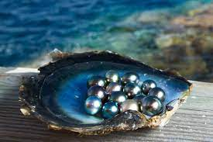
DAA Lecture # 3
Instructor: Naveera Sami

Slide 2
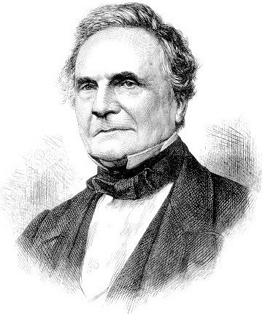
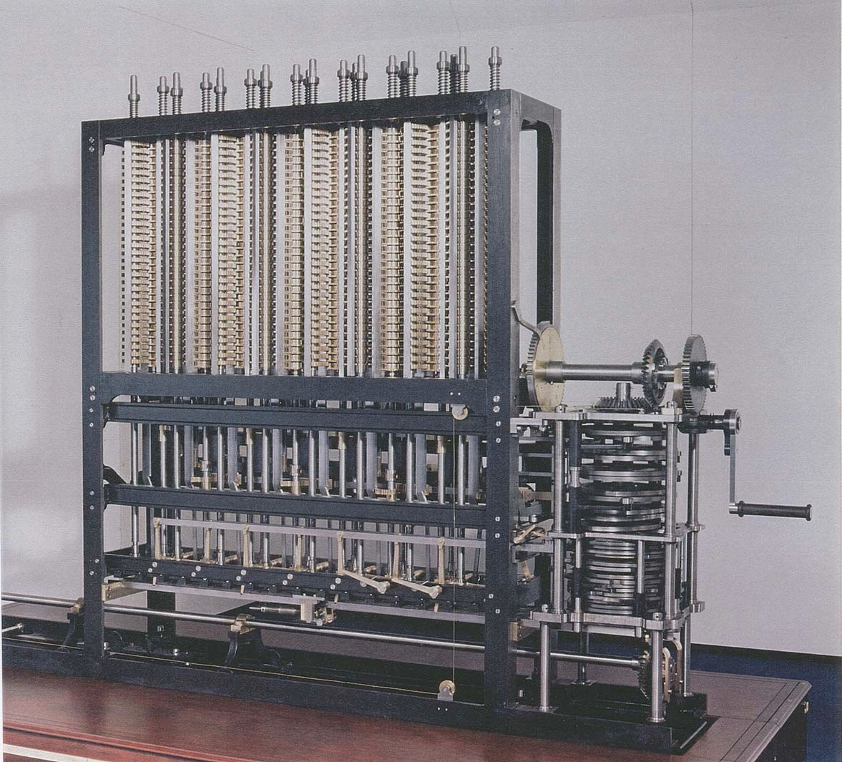
A strikingly modern thought
“ As soon as an Analytic Engine exists, it will necessarily guide the future course of the science. Whenever any result is sought by its aid, the question will arise—By what course of calculation can these results be arrived at by the machine in the shortest time? ” — Charles Babbage (1864)
how many times do you have to turn the crank?
Analytic Engine

Slide 3
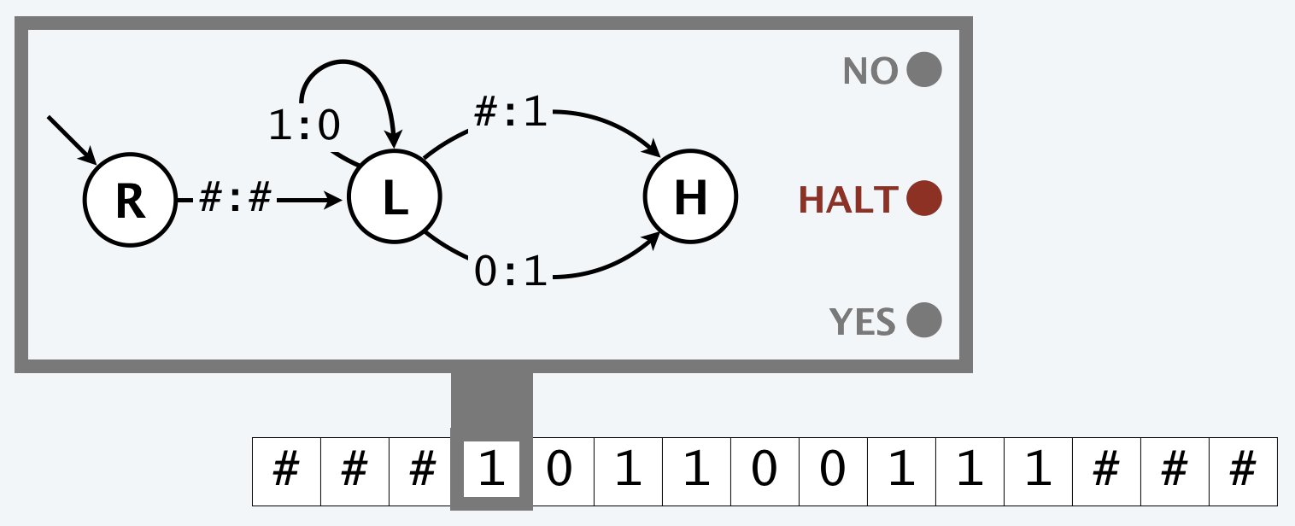
Models of computation: Turing machines
Deterministic Turing machine. Simple and idealistic model.
Running time. Number of steps. Memory. Number of tape cells utilized.
Caveat. No random access of memory.
・Single-tape TM requires ≥ n² steps to detect n-bit palindromes.
・Easy to detect palindromes in ≤ cn steps on a real computer.

Slide 4
Models of computation: word RAM
Word RAM.
assume w ≥ log2 n
・Each memory location and input/output cell stores a w-bit integer.
・Primitive operations: arithmetic/logic operations, read/write memory, array indexing, following a pointer, conditional branch, …
constant-time C-style operations (w = 64)
input
 |  |  | …
a[i]
. . .
memory
program
i
output
 |  |  | …
Running time. Number of primitive operations. Memory. Number of memory cells utilized.
Caveat. At times, need more refined model (e.g., multiplying n-bit integers).

Slide 5
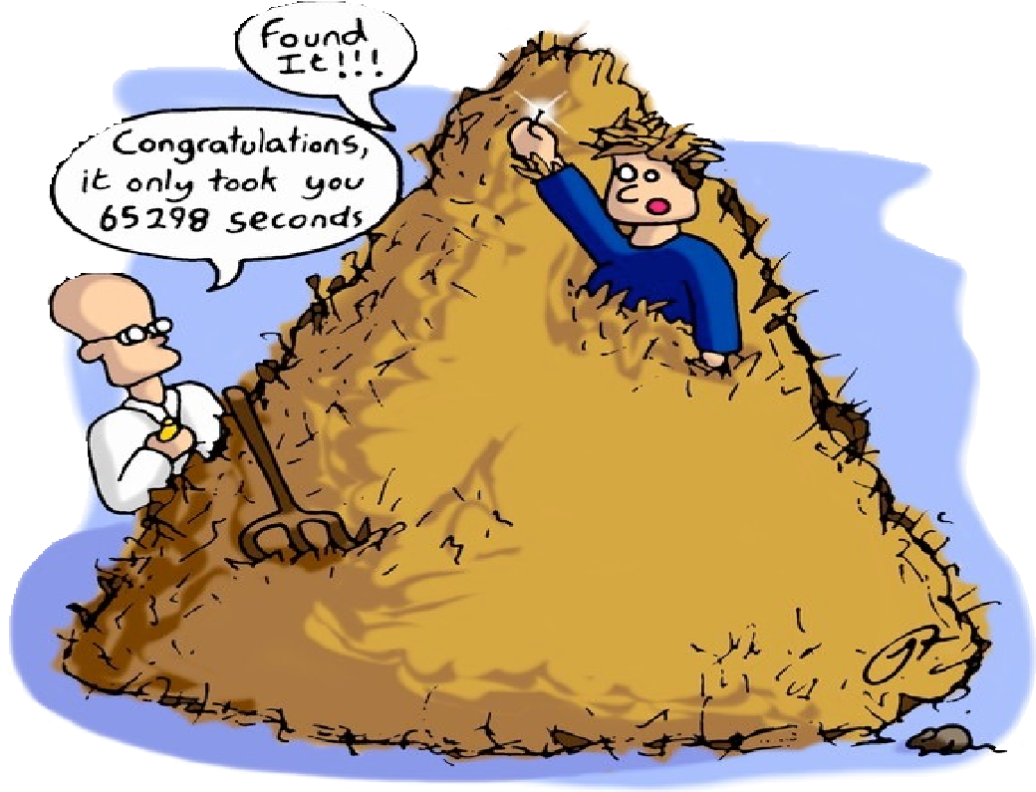
Brute force
Brute force. For many nontrivial problems, there is a natural brute-force search algorithm that checks every possible solution.
・Typically takes 2^{n} steps (or worse) for inputs of size n.
・Unacceptable in practice.
Ex. Stable matching problem: test all n! perfect matchings for stability.

Slide 6
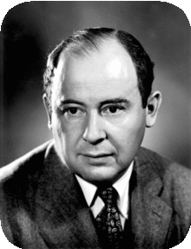
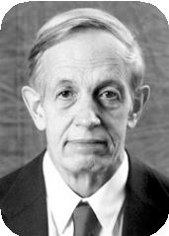
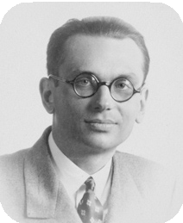
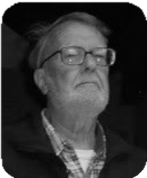
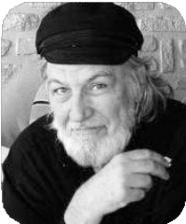
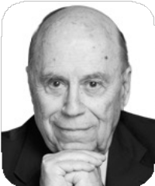
Polynomial running time
Desirable scaling property. When the input size doubles, the algorithm should slow down by at most some multiplicative constant factor C.
Def. An algorithm is poly-time if the above scaling property holds.
There exist constants a > 0 and b > 0 such that, for every input of size n, the algorithm performs
≤ a n^{b} primitive computational steps.
corresponds to C = 2^{b}
von Neumann (1953)
Nash (1955)
Gödel (1956)
Cobham (1964)
Edmonds (1965)
Rabin (1966)

Slide 7
Polynomial running time
We say that an algorithm is efficient if it has a polynomial running time.
Theory. Definition is (relatively) insensitive to model of computation.
Practice. It really works!
・The poly-time algorithms that people develop have both small constants and small exponents.
・Breaking through the exponential barrier of brute force typically exposes some crucial structure of the problem.
_{n}120
Exceptions. Some poly-time algorithms in the wild have galactic constants and/or huge exponents.
Map graphs in polynomial time
Mikkel Thorup
Department of Computer Science, University of Copenhagen Universitetsparken 1, DK-2100 Copenhagen East, Denmark mthorup@diku.dk
Abstract
Chen, Grigni, and Papadimitriou (WADS’97 and STOC’98) have introduced a modified notion of planarity, where two faces are considered adjacent if they share at least one point. The corresponding abstract graphs are called map graphs. Chen et.al. raised the question of whether map graphs can be recognized in polynomial time. They showed that the decision problem is in NP and presented a polynomial time algorithm for the special case where we allow at most 4 faces to intersect in any point — if only 3 are allowed to intersect in a point, we get the usual planar graphs.
Chen et.al. conjectured that map graphs can be recognized in polynomial time, and in this paper, their conjecture is settled affirmatively.
Q. Which would you prefer:
_{20 n}120
or
_{n}1 + 0.02 ln n
?

Slide 8

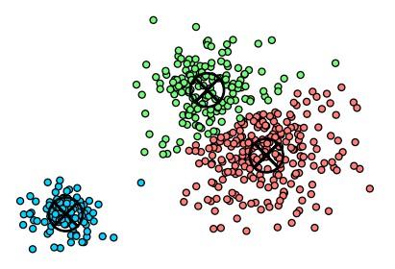
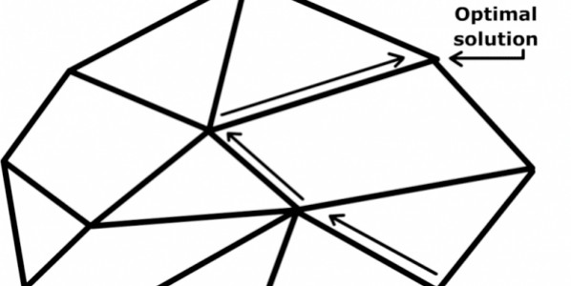
Worst-case analysis
Worst case. Running time guarantee for any input of size n.
・Generally captures efficiency in practice.
・Draconian view, but hard to find effective alternative.
Exceptions. Some exponential-time algorithms are used widely in practice because the worst-case instances don’t arise.
simplex algorithm
Linux grep
k-means algorithm

Slide 9

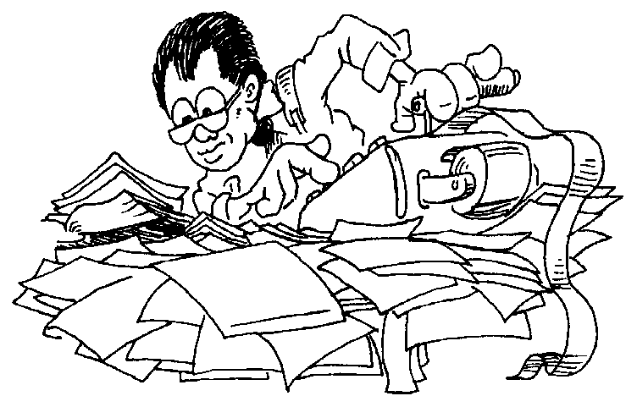
Other types of analyses
Probabilistic. Expected running time of a randomized algorithm.
Ex. The expected number of compares to quicksort n elements is ~ 2n ln n.
Amortized. Worst-case running time for any sequence of n operations.
Ex. Starting from an empty stack, any sequence of n push and pop operations takes O(n) primitive computational steps using a resizing array.
Also. Average-case analysis, smoothed analysis, competitive analysis, ...

Slide 10
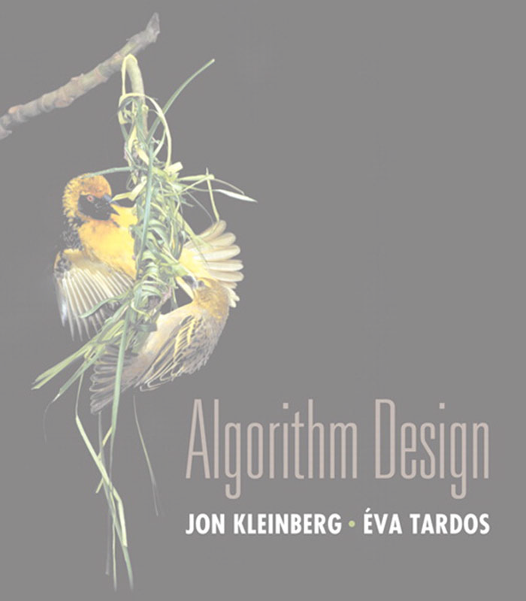

2. Algorithm Analysis
computational tractability
asymptotic order of growth
implementing Gale–Shapley
survey of common running times
Section 2.2

Slide 11
Big O notation
Upper bounds. f (n) is O(g(n)) if there exist constants c > 0 and n₀ ≥ 0
such that 0 ≤ f (n) ≤ c · g (n) for all n ≥ n₀.
c · g(n)
Ex. f (n) = 32n² + 17n + 1.
f (n)
・f (n) is O(n²).
choose c = 50, n0 = 1
・f (n) is neither O(n) nor O(n log n).
n0
n
Typical usage. Insertion sort makes O(n²) compares to sort n elements.
12

Slide 12

Big O notational abuses
One-way “equality.” O(g(n)) is a set of functions, but computer scientists often write f (n) = O(g(n)) instead of f (n) ∈ O(g(n)).
Ex. Consider g1(n) = 5n³ and g2(n) = 3n².
・We have g1(n) = O(n³) and g2(n) = O(n³).
・But, do not conclude g1(n) = g2(n).
Domain and codomain. f and g are real-valued functions.
・The domain is typically the natural numbers: ℕ → ℝ.
・Sometimes we extend to the reals: ℝ≥ 0 → ℝ.
・Or restrict to a subset.
input size, recurrence relations
plotting, limits, calculus
Bottom line. OK to abuse notation in this way; not OK to misuse it.

Slide 13
Big O notation: properties
Reflexivity.
f is O( f ).
Constants. If f is O(g) and c > 0, then c f is O(g).
Products. If f 1 is O(g1) and f 2 is O(g2), then f 1 f 2 is O(g1 g2). Pf.
・∃ c₁ > 0 and n₁ ≥ 0 such that 0 ≤ f 1(n) ≤ c1 · g1(n) for all n ≥ n₁.
・∃ c₂ > 0 and n₂ ≥ 0 such that 0 ≤ f 2(n) ≤ c2 · g2(n) for all n ≥ n₂.
・Then, 0 ≤ f 1(n) · f 2(n) ≤ c1 · c2 · g1(n) · g2(n) for all n ≥ max { n₁, n₂ }. ▪
c n0
Sums. If f 1 is O(g1) and f2 is O(g2), then f 1 + f 2 is O(max {g1, g2}).
ignore lower-order terms
Transitivity. If f is O(g) and g is O(h), then f is O(h).
Ex. f (n) = 5n³ + 3n² + n + 1234 is O(n³).

Slide 14
Big Omega notation
Lower bounds. | f (n) is Ω(g(n)) if there exist constants c > 0 and n₀ | ≥ | 0
such that f (n) ≥ | c · g(n) ≥ 0 for all n ≥ n₀.
f (n)
Ex. f (n) = 32n² + 17n + 1.
・f (n) is both Ω(n²) and Ω(n).
・f (n) is not Ω(n³).
c · g(n)
choose c = 32, n0 = 1
n0
n
Typical usage. Any compare-based sorting algorithm requires Ω(n log n)
compares in the worst case.
Vacuous statement. Any compare-based sorting algorithm requires at least O(n log n) compares in the worst case.

Slide 15
Big Theta notation
Tight bounds. f (n) is Θ(g(n)) if there exist constants c1 > 0, c2 > 0, and n₀ ≥ 0
such that 0 ≤ c1 · g(n) ≤ f (n) ≤ c2 · g(n) for all n ≥ n₀.
c2 · g(n)
f (n)
Ex. f (n) = 32n² + 17n + 1.
・f (n) is Θ(n²).
c1 · g(n)
choose c1 = 32, c2 = 50, n0 = 1
・f (n) is neither Θ(n) nor Θ(n³).
n0
n
Typical usage. Mergesort makes Θ(n log n) compares to sort n elements.
between ½ n log2 n
and n log2 n
19

Slide 16
Asymptotic bounds and limits
Proposition. If
lim
n→∞
f (n)
= c
for some constant 0 < c < ∞ then f (n) is Θ(g(n)).
g(n)
Pf.
・By definition of the limit, for any ε > 0, there exists n₀ such that
f (n)
c — ϵ ≤
≤ c + ϵ
g(n)
for all n ≥ n₀.
・Choose ε = ½ c > 0.
・Multiplying by g(n) yields
1/2 c · g(n) ≤ f (n) ≤ 3/2 c · g(n) for all n ≥ n₀.
・Thus, f (n) is Θ(g(n)) by definition, with c1 = 1/2 c and c2 = 3/2 c. ▪
f (n)
Proposition. If lim
n→∞
g(n)
= 0 , then f (n) is O(g(n)) but not Ω(g(n)).
f (n)
Proposition. If lim
n→∞
g(n)
= ∞ , then f (n) is Ω(g(n)) but not O(g(n)).
21

Slide 17
Asymptotic bounds for some common functions
Polynomials. Let f (n) = a₀ + a₁ n + … + a_{d} n^{d} with a_{d} > 0. Then, f (n) is Θ(n^{d} ). Pf.
lim
n→∞
a₀ + a₁n + .. . + a_{d}n^{d}
= a_{d} > 0
n
d
Logarithms.
log_{a} n is Θ(log_{b} n) for every a > 1 and every b > 1.
Pf.
log_{a} n ₌ 1
no need to specify base (assuming it is a constant)
log_{b} n log_{b} a
Logarithms and polynomials. Pf.
loga n is O(n^{d} ) for every a > 1 and every d > 0.
log_{a} n
lim
n→∞
= 0
n
d
Exponentials and polynomials. Pf. _{n}d
_{n}d
is O(r^{n} ) for every r > 1 and every d > 0.
lim = 0
n→∞ r
n
Factorials.
_{n! is 2}Θ(n log n).
√
n e
n
Pf. Stirling’s formula:
n! ~ 2πn
22

Slide 18
Big O notation with multiple variables
Upper bounds. f (m, n) is O(g(m, n)) if there exist constants c > 0, m₀ ≥ 0, and n₀ ≥ 0 such that 0 ≤ f (m, n) ≤ c · g (m, n) for all n ≥ n₀ or m ≥ m₀.
Ex. f (m, n) = 32mn² + 17mn + 32n³.
・f (m, n) is both O(mn² + n³) and O(mn³).
・f (m, n) is O(n³) if a precondition to the problem implies m ≤ n.
・f (m, n) is neither O(n³) nor O(mn²).
Typical usage. In the worst case, breadth-first search takes O(m + n) time to find a shortest path from s to t in a digraph with n nodes and m edges.
23

Slide 19
Efficient implementation
Goal. Implement Gale–Shapley to run in O(n ²) time.
GALE–SHAPLEY (preference lists for n hospitals and n students) INITIALIZE M to empty matching.
WHILE (some hospital h is unmatched)
s ← first student on h’s list to whom h has not yet proposed. IF (s is unmatched)
Add h–s to matching M.
ELSE IF (s prefers h to current partner hʹ) Replace hʹ–s with h–s in matching M.
Else
s rejects h.
RETURN stable matching M.

Slide 20
Efficient implementation
Goal. Implement Gale–Shapley to run in O(n ²) time.
Representing hospitals and students. Index hospitals and students 1, …, n. Representing the matching.
・Maintain two arrays student[h] and hospital[s].
-
-
if h matched to s, then student[h] = s and hospital[s] = h
use value 0 to designate that hospital or student is unmatched
・Can add/remove a pair from matching in O(1) time.
・Maintain set of unmatched hospitals in a queue (or stack).
・Can find an unmatched hospital in O(1) time.

Slide 21
Data representation: making a proposal
Hospital makes a proposal.
・Key operation: find hospital’s next favorite student.
・For each hospital: maintain a list of students, ordered by preference.
・For each hospital: maintain a pointer to student for next proposal.
next proposal to
3
4
1
5
2
null
hospital h
favorite
least favorite
Bottom line. Making a proposal takes O(1) time.

Slide 22
Data representation: accepting/rejecting a proposal
Student accepts/rejects a proposal.
・Does student s prefer hospital h to hospital hʹ ?
・For each student, create inverse of preference list of hospitals.
₁st ₂nd ₃rd ₄th ₅th ₆th ₇th ₈th
pref[]
8 3 7 1 4 5 6 2
student prefers hospital 4 to 6 since rank[4] < rank[6]
rank[]
1 2 3 4 5 6 7 8
₄th ₈th ₂nd ₅th ₆th ₇th ₃rd ₁st
for i = 1 to n rank[pref[i]] = i
Bottom line. After Θ(n²) preprocessing time (to create the n ranking arrays), it takes O(1) time to accept/reject a proposal.

Slide 23
Stable matching: summary
Theorem. Can implement Gale–Shapley to run in O(n²) time. Pf.
・Θ(n²) preprocessing time to create the n ranking arrays.
・There are O(n²) proposals; processing each proposal takes O(1) time. ▪
Theorem. In the worst case, any algorithm to find a stable matching must query the hospital’s preference list Ω(n²) times.

Slide 24
Constant time
Constant time. Running time is O(1).
Examples.
・Conditional branch.
・Arithmetic/logic operation.
・Declare/initialize a variable.
・Follow a link in a linked list.
bounded by a constant,
which does not depend on input size n
・Access element i in an array.
・Compare/exchange two elements in an array.
・…

Slide 25
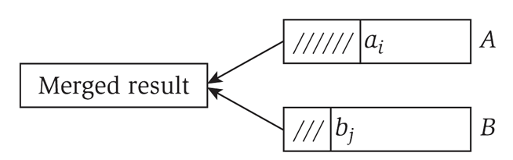
Linear time
Linear time. Running time is O(n).
Merge two sorted lists. Combine two sorted linked lists A = a₁, a₂, …, a_{n} and
B = b₁, b₂, …, b_{n} into a sorted whole.
O(n) algorithm. Merge in mergesort.
i ← 1; j ← 1.
WHILE (both lists are nonempty)
IF (ai ≤ bj) append ai to output list and increment i. ELSE append bj to output list and increment j.
Append remaining elements from nonempty list to output list.

Slide 26

Target Sum
TARGET-SUM. Given a sorted array of n distinct integers and an integer T, find two that sum to exactly T ?
input (sorted)
−20
10
20
30
35
40
60
70
T = 60
i
j
26

Slide 27
Target Sum
TARGET-SUM. Given a sorted array of n distinct integers and an integer T, find two that sum to exactly T ?
O(n²) algorithm. Try all pairs.
O(n) algorithm. Exploit sorted order.
input (sorted)
−20 10
20
30
35
40
60 70
T = 60
i
j
Invariant. No element to the left of i or right of j in pair that sums to T.
27

Slide 28

Logarithmic time
Logarithmic time. Running time is O(log n).
Search in a sorted array. Given a sorted array A of n distinct integers and an integer x, find index of x in array.
O(log n) algorithm. Binary search.
remaining elements
・Invariant: If x is in the array, then x is in A[lo .. hi].
・After k iterations of WHILE loop, (hi − lo + 1) ≤ n / 2^{k}
→ k ≤ 1 + log2 n.
lo ← 1; hi ← n.
While mid | (lo ≤ hi) ← ⎣(lo + hi) / 2⎦.
If | (x < A[mid]) | hi ← mid − 1.
ELSE IF (x > A[mid]) lo ← mid + 1. ELSE RETURN mid.
Return −1.
35

Slide 29
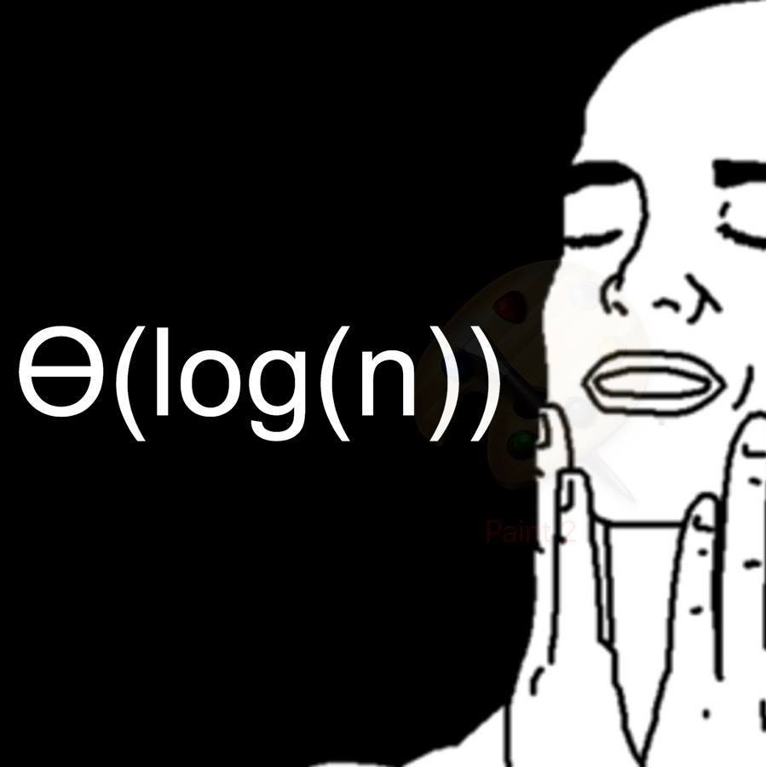

Logarithmic time
O(log n)
https://www.facebook.com/pg/npcompleteteens

Slide 30
Search in a sorted rotated array
SEARCH-IN-SORTED-ROTATED-ARRAY. Given a rotated sorted array of n distinct integers and an element x, determine if x is in the array.
sorted circular array
20
95
30
90
35
85
50
80
60
75
67
65
sorted rotated array
80 | 85 | 90 | 95 | 20 | 30 | 35 | 50 | 60 | 65 | 67 | 75
1
2
3
4
5
6
7
8
9
10
11
12
30

Slide 31

Search in a sorted rotated array
SEARCH-IN-SORTED-ROTATED-ARRAY. Given a rotated sorted array of n distinct integers and an element x, determine if x is in the array.
O(log n) algorithm.
・Find index k of smallest element.
・Binary search for x in either A[1 .. k−1] or A[k .. n].
find index of smallest element
lo ← 1; hi ← n.
IF (A[lo] ≤ A[hi]) RETURN 0
sorted
WHILE (lo + 2 ≤ hi) mid ← ⎣(lo + hi) / 2⎦.
at least 3 elements
IF (A[mid] < A[hi]) ELSE IF (A[mid] > A[hi])
Return hi
hi ← mid. lo ← mid.
loop invariant
A[lo] > A[hi]
31

Slide 32
Linearithmic time
Linearithmic time. Running time is O(n log n).
Sorting. Given an array of n elements, rearrange them in ascending order.
O(n log n) algorithm. Mergesort.
0 | 1 | 2 | 3 | 4 | 5 | 6 | 7 | 8 | 9 | 10 | 11 | 12 | 13 | 14 | 15
M | E | R | G | E | S | O | R | T | E | X | A | M | P | L | E
E | M | R | G | E | S | O | R | T | E | X | A | M | P | L | E
E | M | G | R | E | S | O | R | T | E | X | A | M | P | L | E
E | G | M | R | E | S | O | R | T | E | X | A | M | P | L | E
E | G | M | R | E | S | O | R | T | E | X | A | M | P | L | E
E | G | M | R | E | S | O | R | T | E | X | A | M | P | L | E
E | G | M | R | E | O | R | S | T | E | X | A | M | P | L | E
E | E | G | M | O | R | R | S | T | E | X | A | M | P | L | E
E | E | G | M | O | R | R | S | E | T | X | A | M | P | L | E
E | E | G | M | O | R | R | S | E | T | A | X | M | P | L | E
E | E | G | M | O | R | R | S | A | E | T | X | M | P | L | E
E | E | G | M | O | R | R | S | A | E | T | X | M | P | L | E
E | E | G | M | O | R | R | S | A | E | T | X | M | P | E | L
E | E | G | M | O | R | R | S | A | E | T | X | E | L | M | P
E | E | G | M | O | R | R | S | A | E | E | L | M | P | T | X
A | E | E | E | E | G | L | M | M | O | P | R | R | S | T | X
39

Slide 33
Largest Empty interval
LARGEST-EMPTY-INTERVAL. Given n timestamps x₁, …, x_{n} on which copies of a file arrive at a server, what is largest interval when no copies of file arrive?
33

Slide 34
Largest Empty interval
LARGEST-EMPTY-INTERVAL. Given n timestamps x₁, …, x_{n} on which copies of a file arrive at a server, what is largest interval when no copies of file arrive?
O(n log n) algorithm.
・Sort the array a.
・Scan the sorted list in order, identifying the maximum gap between successive timestamps.
34

Slide 35
Quadratic time
Quadratic time. Running time is O(n²).
Closest pair of points. Given a list of n points in the plane (x₁, y₁), …, (x_{n}, y_{n}), find the pair that is closest to each other.
O(n²) algorithm. Enumerate all pairs of points (with i < j).
min ← ∞. FOR i = 1 TO n
FOR j = i + 1 TO n
d ← (xi − xj)² + (yi − yj)².
IF (d < min) min ← d.
Remark. Ω(n²) seems inevitable, but this is just an illusion. [see §5.4]

Slide 36
Cubic time
Cubic time. Running time is O(n³).
3-SUM. Given an array of n distinct integers, find three that sum to 0.
O(n³) algorithm. Enumerate all triples (with i < j < k).
For i = 1 to n
FOR j = i + 1 TO n
FOR k = j + 1 TO n
IF (ai + aj + ak = 0) RETURN (ai, aj, ak).
Remark. Ω(n³) seems inevitable, but O(n²) is not hard. [see next slide]

Slide 37
3-SUM
3-SUM. Given an array of n distinct integers, find three that sum to 0.
O(n³) algorithm. Try all triples.
O(n²) algorithm.
37

Slide 38
3-SUM
3-SUM. Given an array of n distinct integers, find three that sum to 0.
O(n³) algorithm. Try all triples.
O(n²) algorithm.
・Sort the array a.
・For each integer ai : solve TARGET-SUM on the array containing all elements except ai with the target sum T = −ai.
Best-known algorithm. O(n² / (log n / log log n)). Conjecture. No O(n^{2−ε}) algorithm for any ε > 0.
38

Slide 39
Polynomial time
Polynomial time. Running time is O(n^{k}) for some constant k > 0.
Independent set of size k. Given a graph, find k nodes such that no two are joined by an edge.
k is a constant
O(n^{k}) algorithm. Enumerate all subsets of k nodes.
FOREACH subset S of k nodes:
Check whether S is an independent set. IF (S is an independent set)
Return S.
independent set of size 3
・Check whether S is an independent set of size k takes O(k²) time.
・Number of k-element subsets =
・O(k² n^{k} / k!) = O(n^{k}).
n k
_{n}k
=
n(n — 1)(n — 2) × ·· · × (n — k + 1)
≤
k(k — 1)(k — 2) × ·· · × 1
k!
poly-time for k = 17, but not practical
46

Slide 40
Exponential time
Exponential time. Running time is O(2^{nk} ) for some constant k > 0.
Independent set. Given a graph, find independent set of max size.
O(n² 2^{n}) algorithm. Enumerate all subsets of n elements.
S* ← ∅.
FOREACH subset S of n nodes:
Check whether S is an independent set.
IF (S is an independent set and ⎮S⎮ > ⎮S*⎮)
S* ← S. Return S*.
independent set of max size

Slide 41
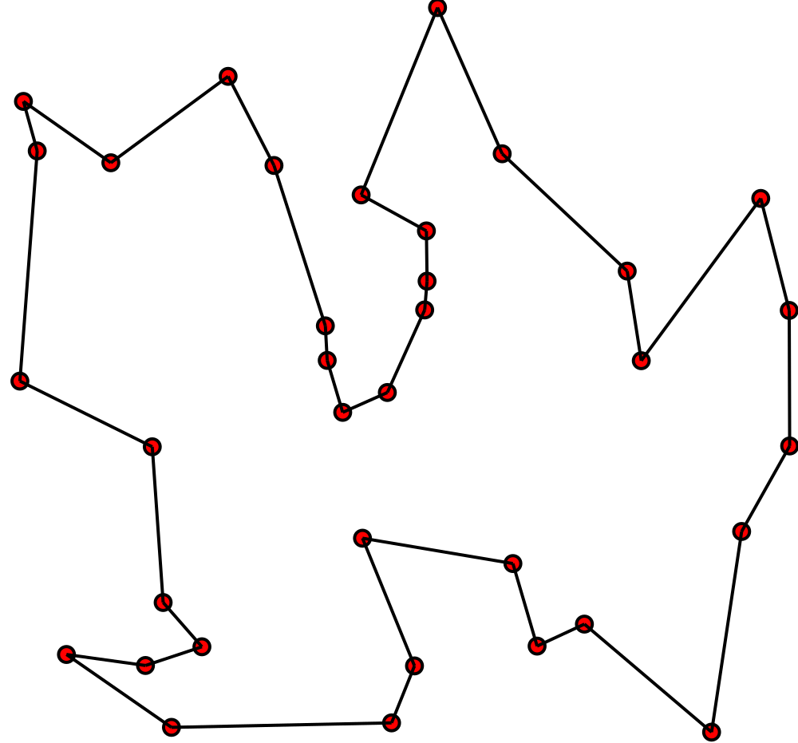
Exponential time
Exponential time. Running time is O(2^{nk} ) for some constant k > 0.
Euclidean TSP. Given n points in the plane, find a tour of minimum length.
O(n 𐄂 n!) algorithm. Enumerate all permutations of length n.
π* ← ∅.
FOREACH permutation π of n points: Compute length of tour corresponding to π. IF (length(π) < length(π*))
π* ← π.
for simplicity, we’ll assume Euclidean
RETURN π*.
distances are rounded to nearest integer (to avoid issues with infinite precision)

